Slide 1
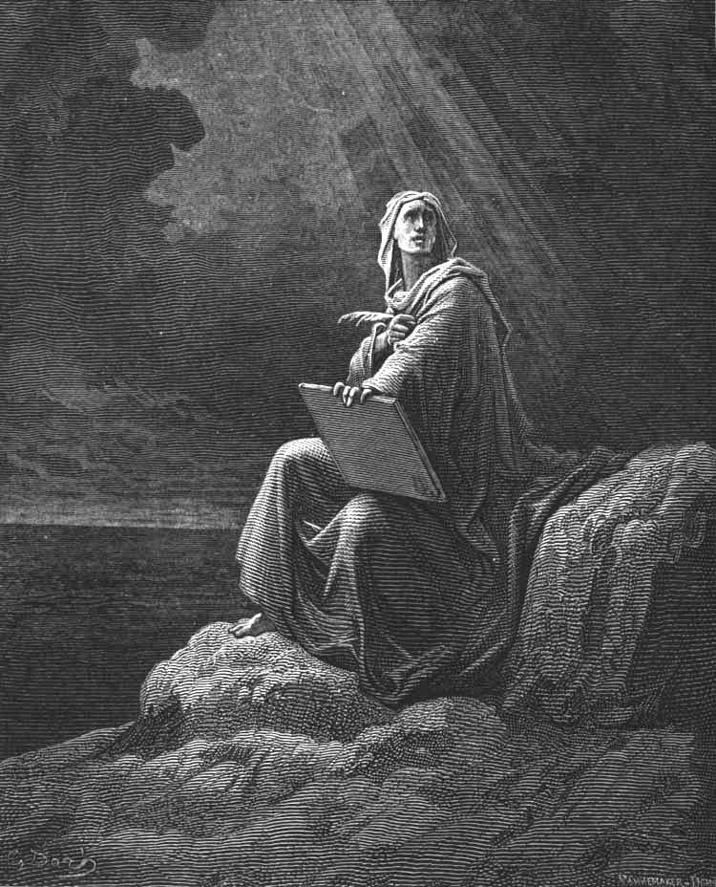

Revelation
Chapter 4:
Chapter 4:
Deliverance
Bible
Institute
Vision of the Throne Room
Vision of the Throne Room

Slide 2
Review
Things Seen
Things Which Are
Things Hereafter
Chapters 2 & 3
Chapter 1
Chapters 4-22
2

Slide 3
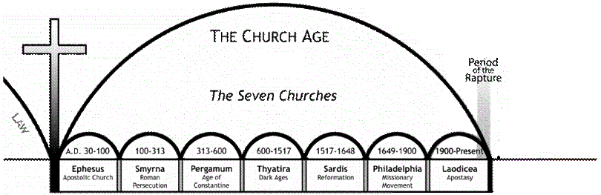



Things in Heaven
Period of Translation
7 Years of Tribulation
1,000 Years
3

Slide 4
Revelation 4 Outline
Rapture of the Church
Throne of Majesty
Twenty-Four Elders
Four Living Creatures
4

Slide 5
Rapture of the Church
Vs. 1-2
After this I looked, and, behold, a door was opened in heaven: and the first voice which I heard was as it were of a trumpet talking with me; which said, Come up hither, and I will shew thee things which must be hereafter.
2 And immediately I was in the spirit:…
5

Slide 6
Rapture of the Church
He Saw a Door Open
…a door was opened in heaven…
He Heard a Voice
…voice which I heard was as it were of a trumpet…Come up hither…
6

Slide 7
Rapture of the Church
I Thessalonians 4:16-17
16 For the Lord himself shall descend from heaven with a shout, with the voice of the archangel, and with the trump of God: and the dead in Christ shall rise first:
17 Then we which are alive and remain shall be caught up together with them in the clouds, to meet the Lord in the air: and so shall we ever be with the Lord.
7

Slide 8
Rapture of the Church
He Saw a Door Open
…a door was opened in heaven…
He Heard a Voice
…voice which I heard was as it were of a trumpet…Come up hither…
He Was Caught Up
…immediately I was in the spirit…
8

Slide 9
Rapture of the Church
Translation
Rapture
The Church is at the Throne of God
Ch. 1 -3 “Church Age”
Ch. 4 “Opens at the Throne of God”
9

Slide 10
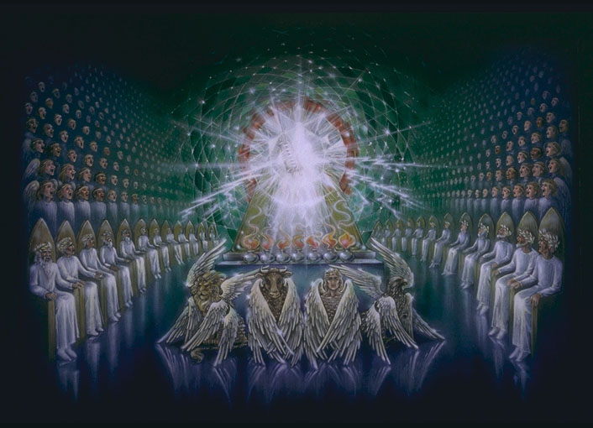
Throne of Majesty
24 Elders
4 Living Creatures
10

Slide 11
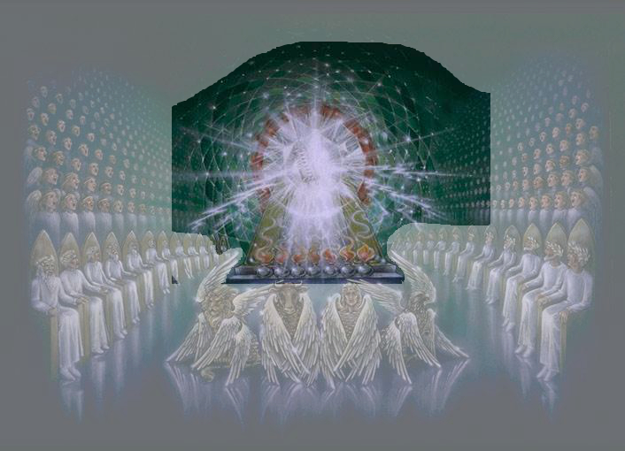
Throne of Majesty
In Heaven
- Occupied
- Encircled
- Judgment
11

Slide 12
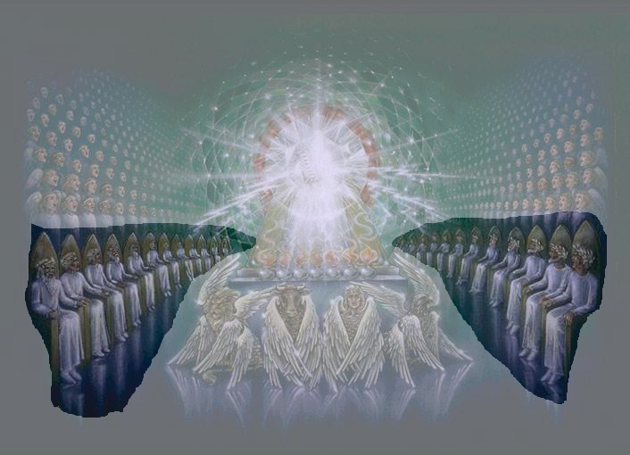
Twenty-Four Elders
12

Slide 13
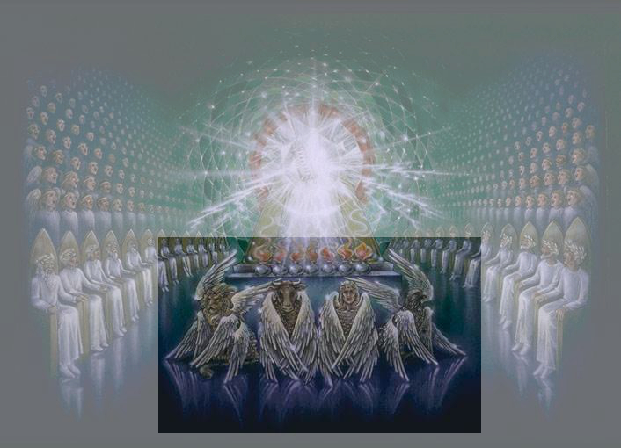
Four Living Creatures
13

Slide 14
Revelation
Chapter 4:
Chapter 4:
Deliverance
Bible
Institute
Vision of the Throne Room
Vision of the Throne Room

